Slide 1
Exploring Multiprocessing through numba, jit, cuda in Python and an Ablation studies over a Machine Translation model using Transformers Architecture
Team 9
Ketaki Kolhatkar Luv Verma

Slide 2
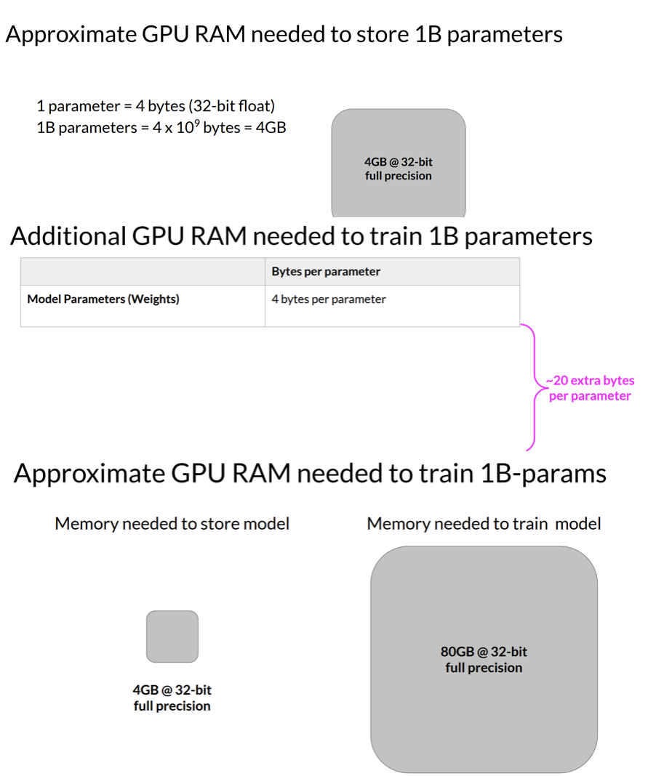
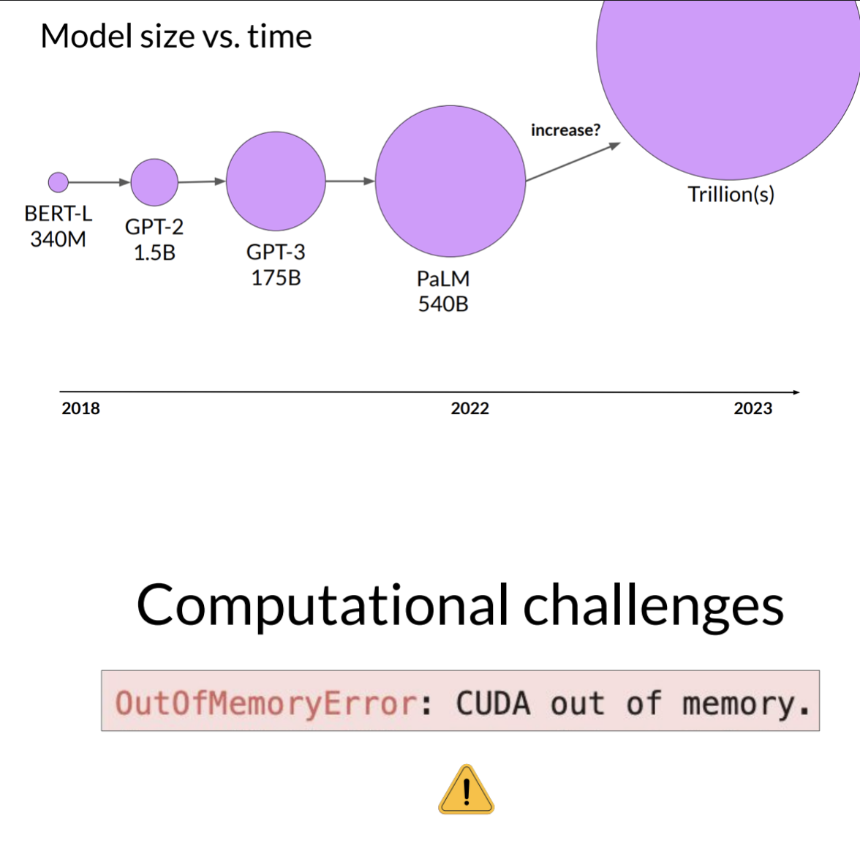
Motivation: Part 1

Slide 3
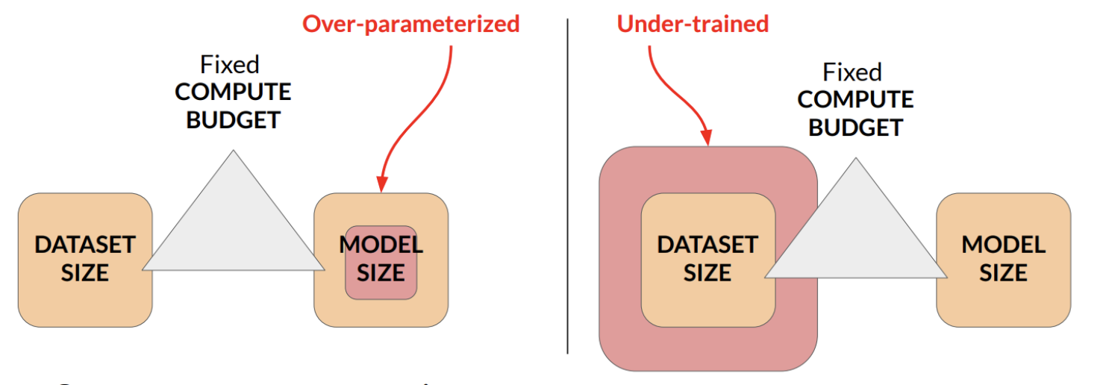
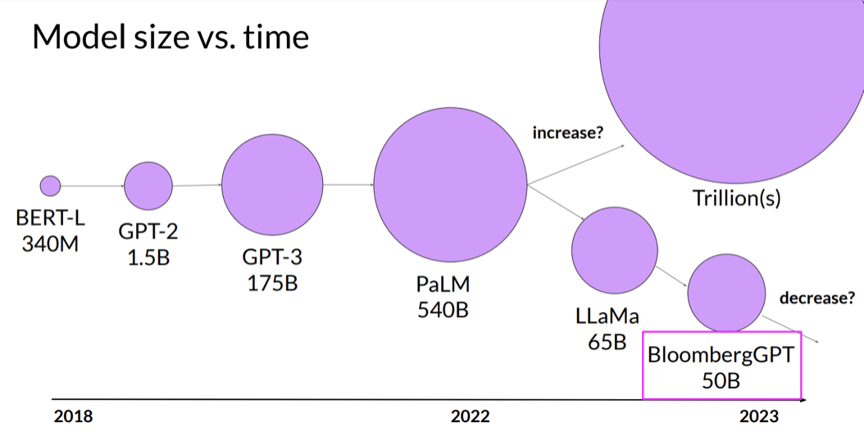
Motivation: Part 2
Compute resource constraint:
Hardware
Project timeline
Financial Budget

Slide 4
Objectives
Understanding the multiprocessing from basics using cuda in Python
Picking up a simple task such as a machine translation using transformers model and perform an ablation studies with computational restraints to understand how dealing with the problem of overparameterization can lead to saving resources in multiprocessing settings

Slide 5
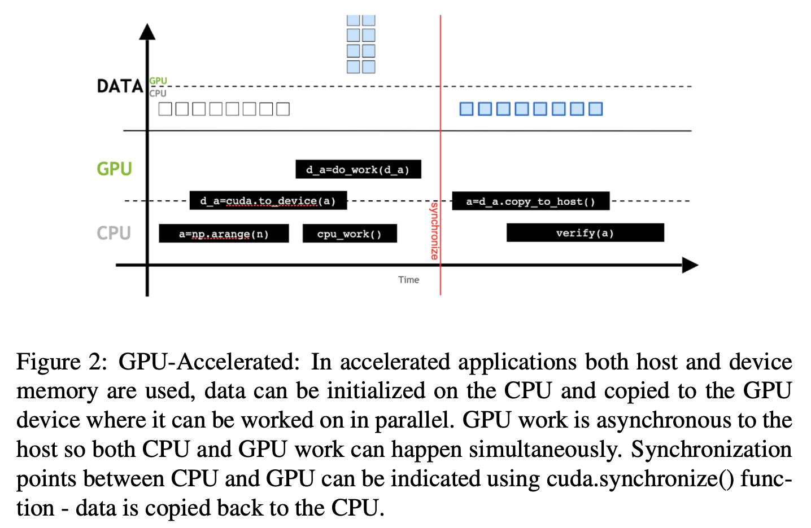
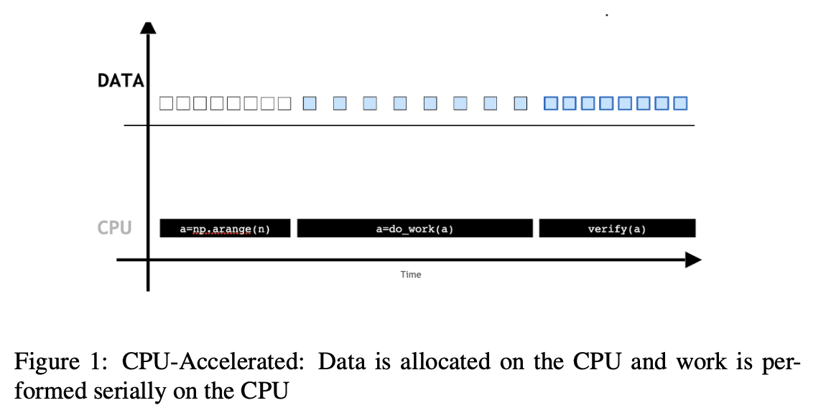
Data Distribution: CPU vs GPU

Slide 6
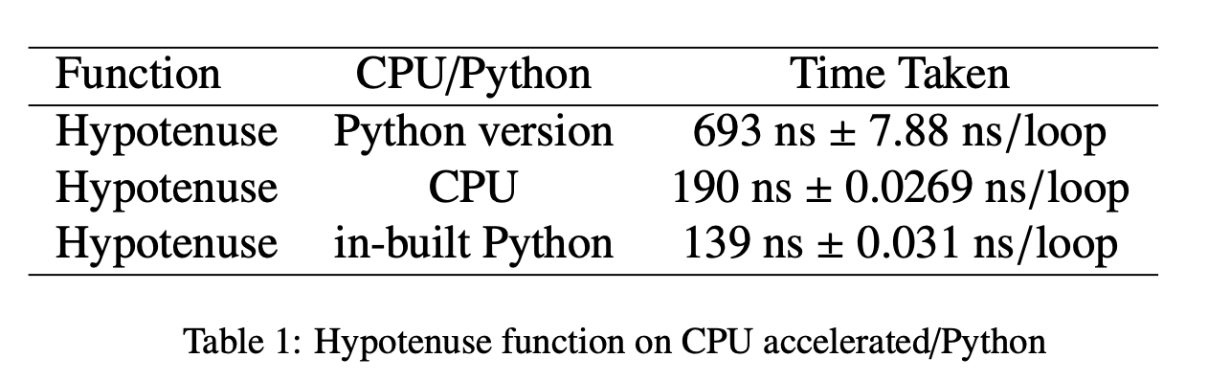
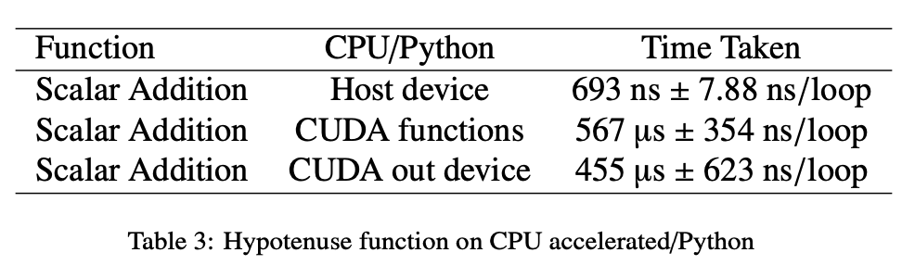
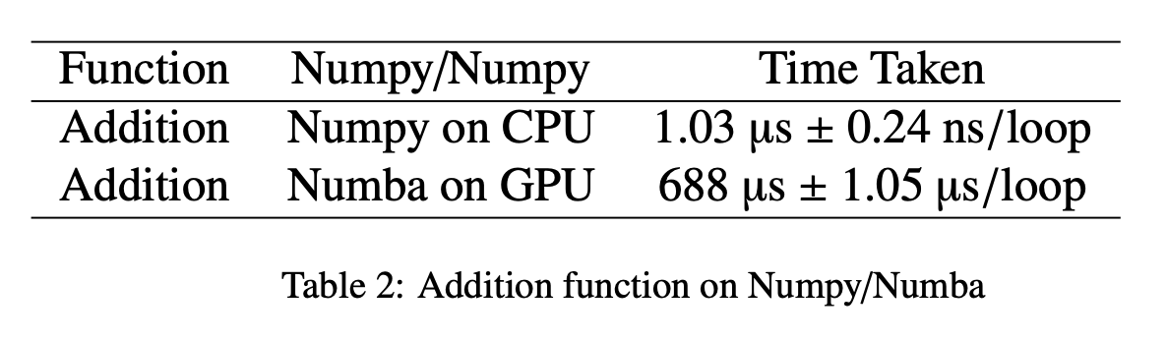
Accelerated Python Experiments

Slide 7
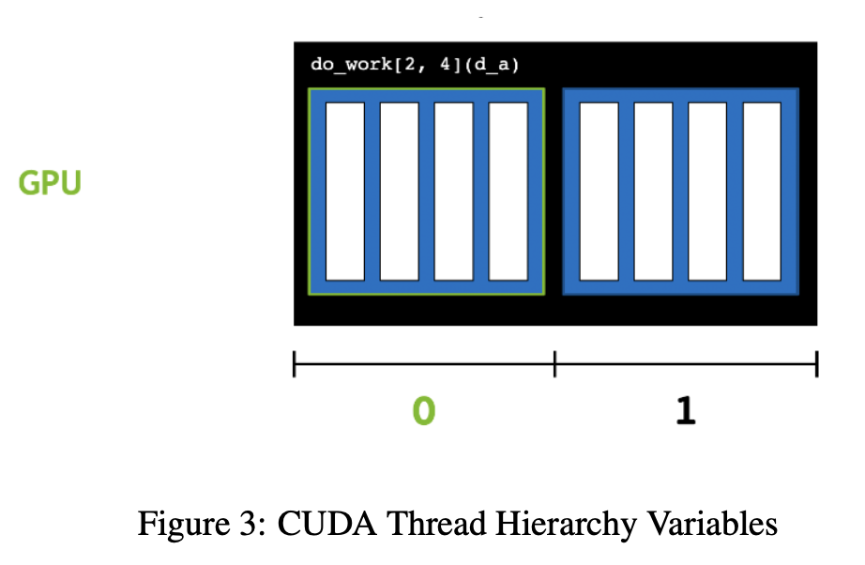
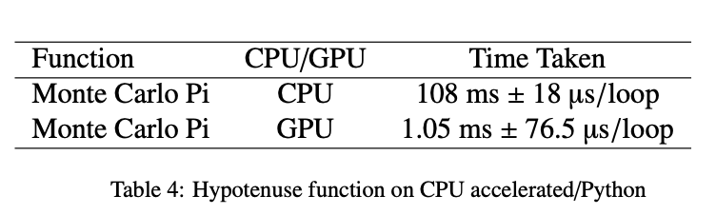
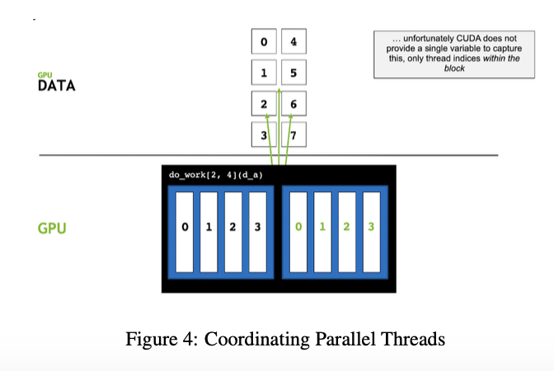
Grid Stride Loop

Slide 8

Experimental Details
Task: Machine Translation from English to Spanish
Data: spa (English to Spanish)
Train Data: 1 million translations
Training: 70 %
Validation: 30%
Architecture: Complete Encoder/Decoder Pipeline

Slide 9
Experimental Details
Parameters to ablate on: Embedding dimensions (referred to as model size), number of heads in one multi-head attention encoder/decoder block; number of multi-head attentions in encoder/decoder block; Dropouts; Epochs (limited to 100 for ablation). Went to 400 for checking overfitting.
Resources: 8 hours of run time, single a100 GPU with 32 cores and 64 gb ram.
Metrics: Validation Loss/ Perplexity (did not consider BLEU score) as that would have not lead to developing an understanding of what is happening per epoch.

Slide 10
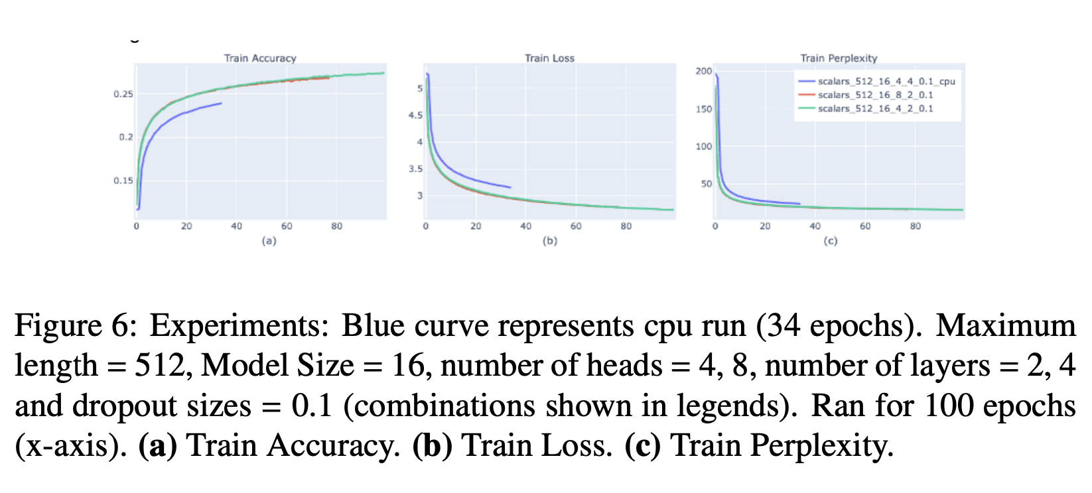
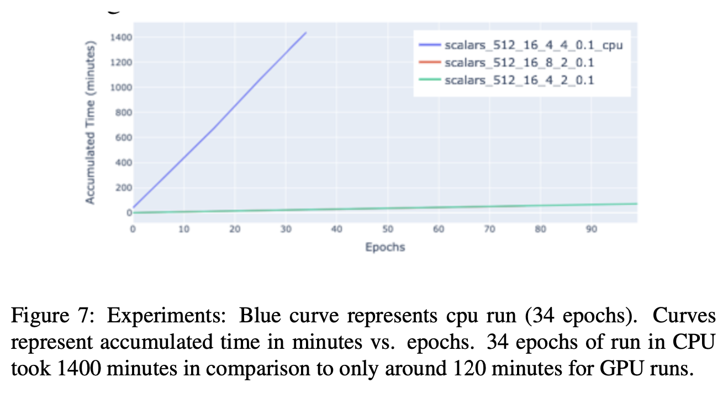
Results with model size 16 on CPU

Slide 11
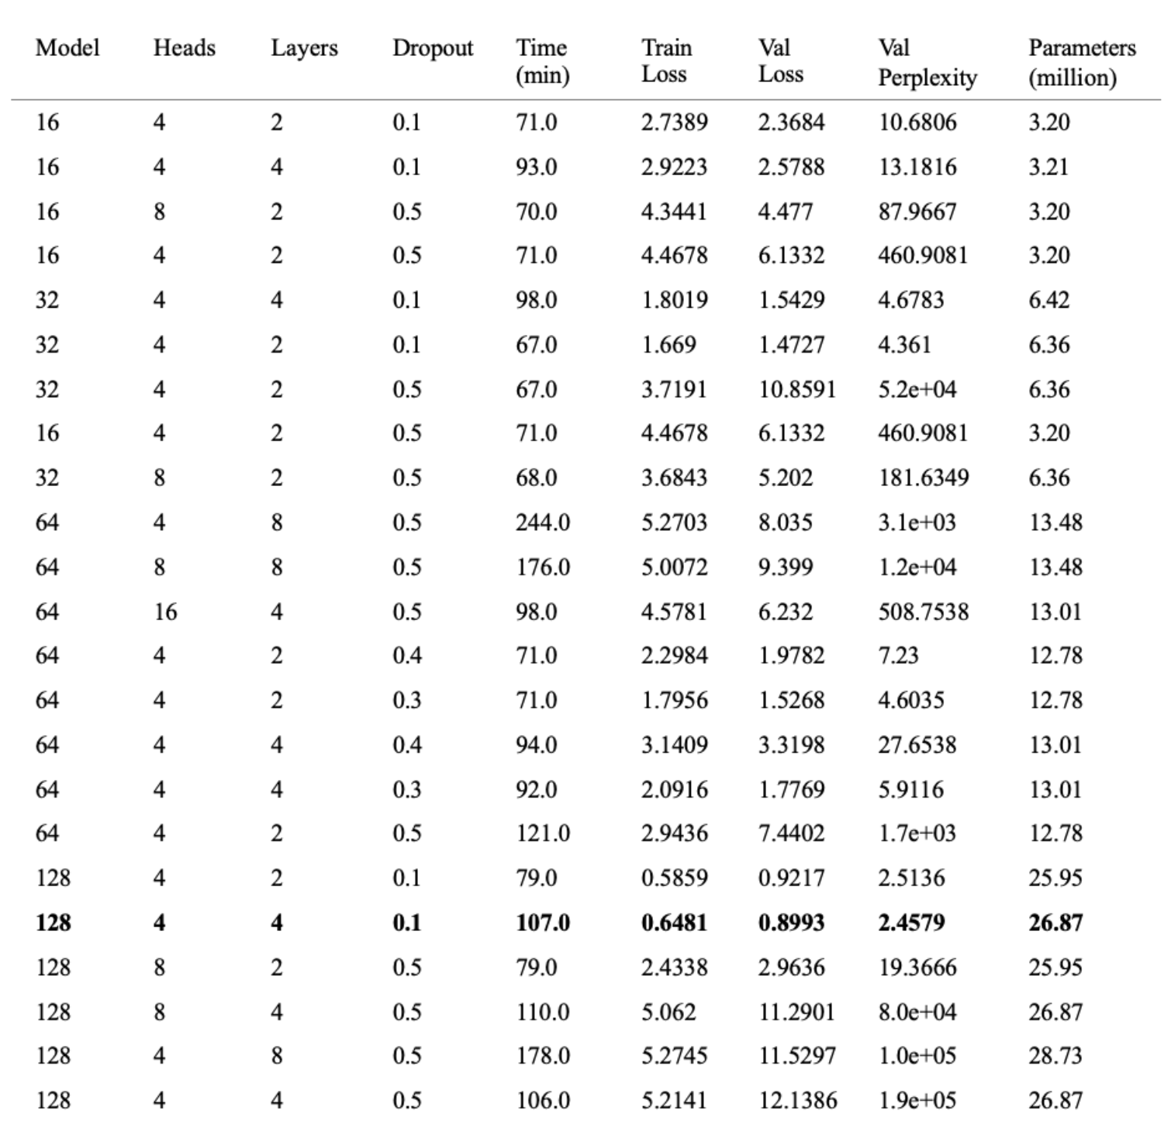
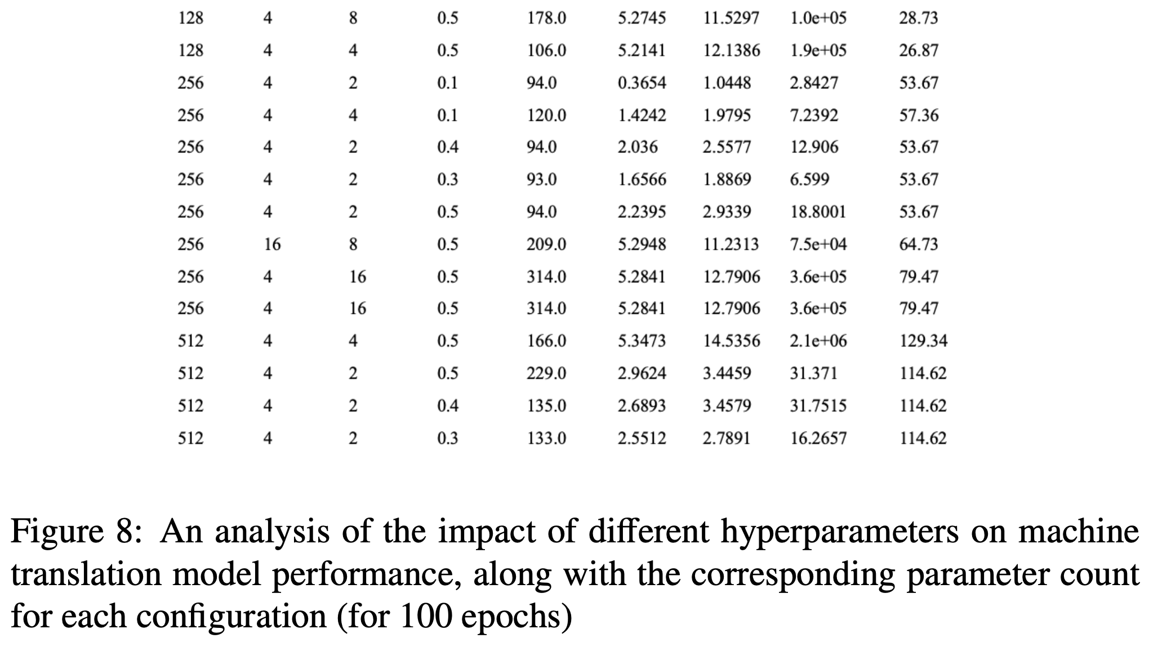
Different Hyperparameters Performance

Slide 12
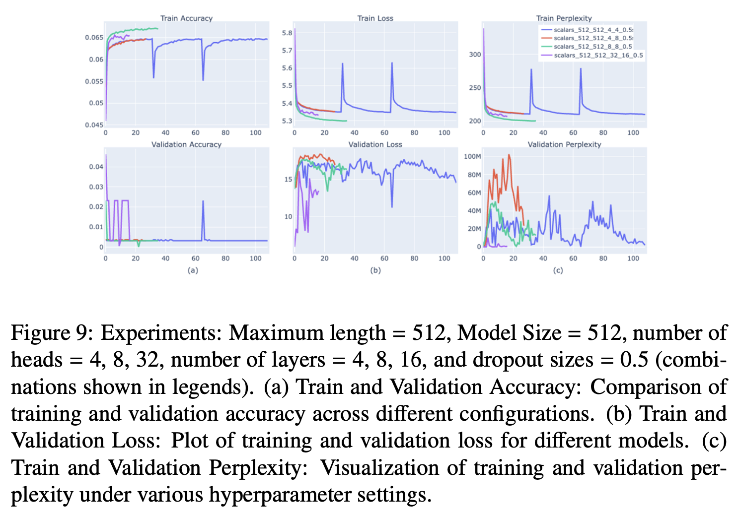
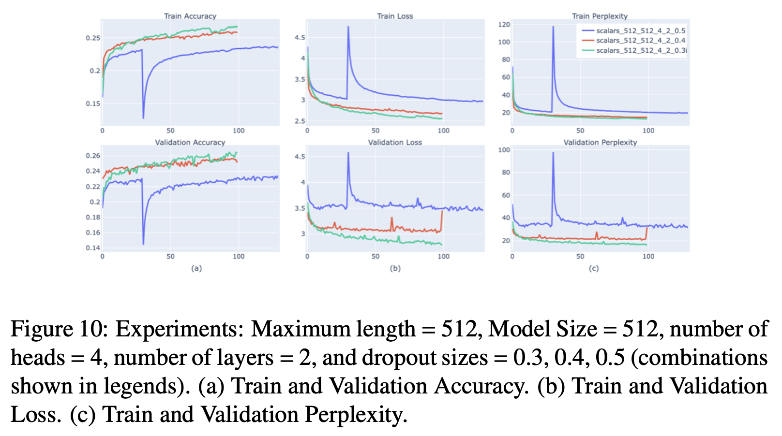
Results with model size 512

Slide 13
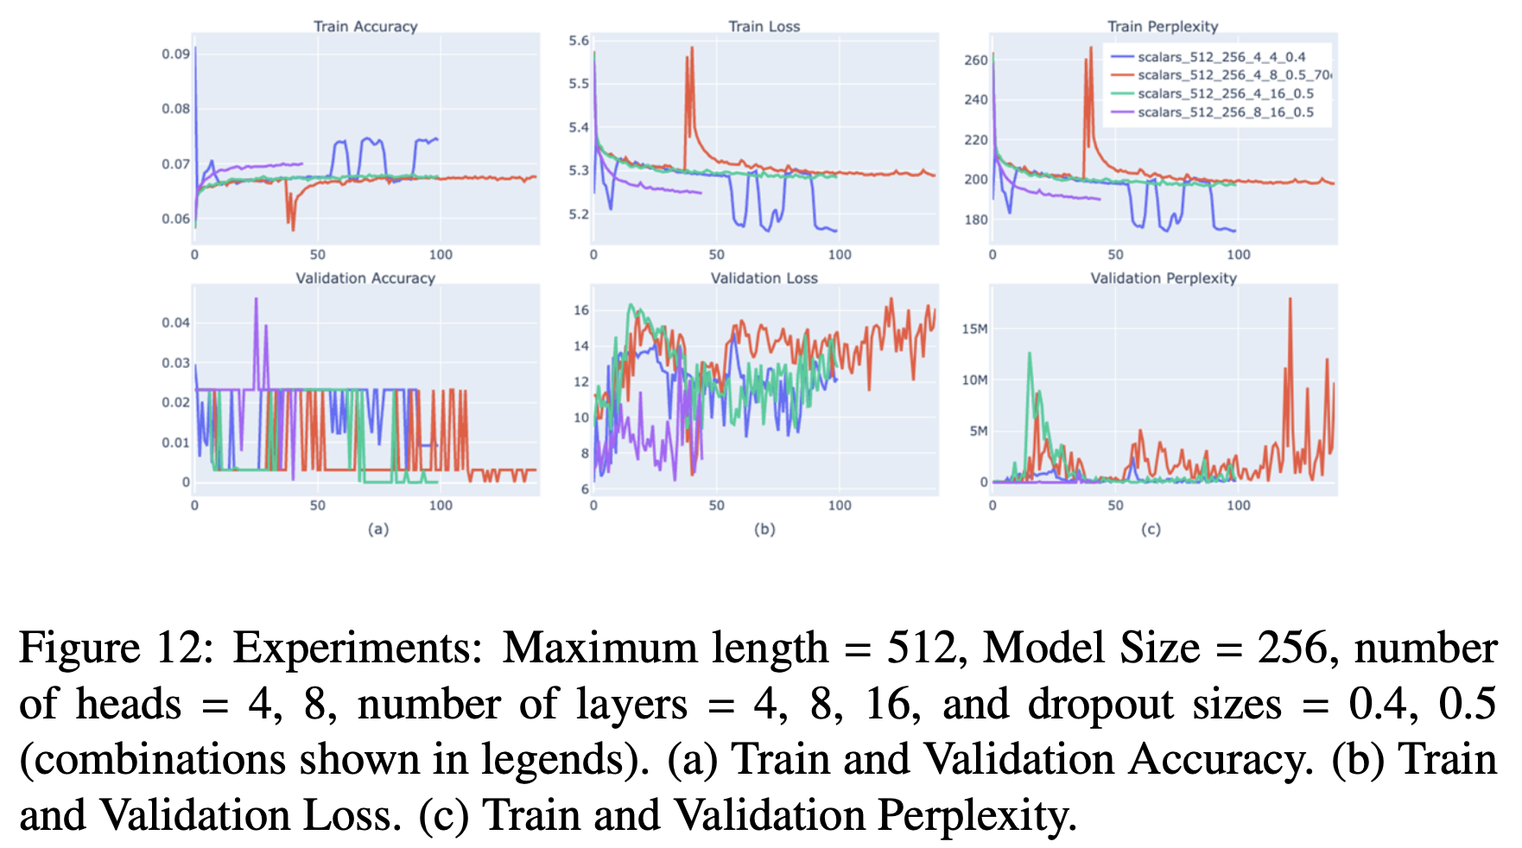
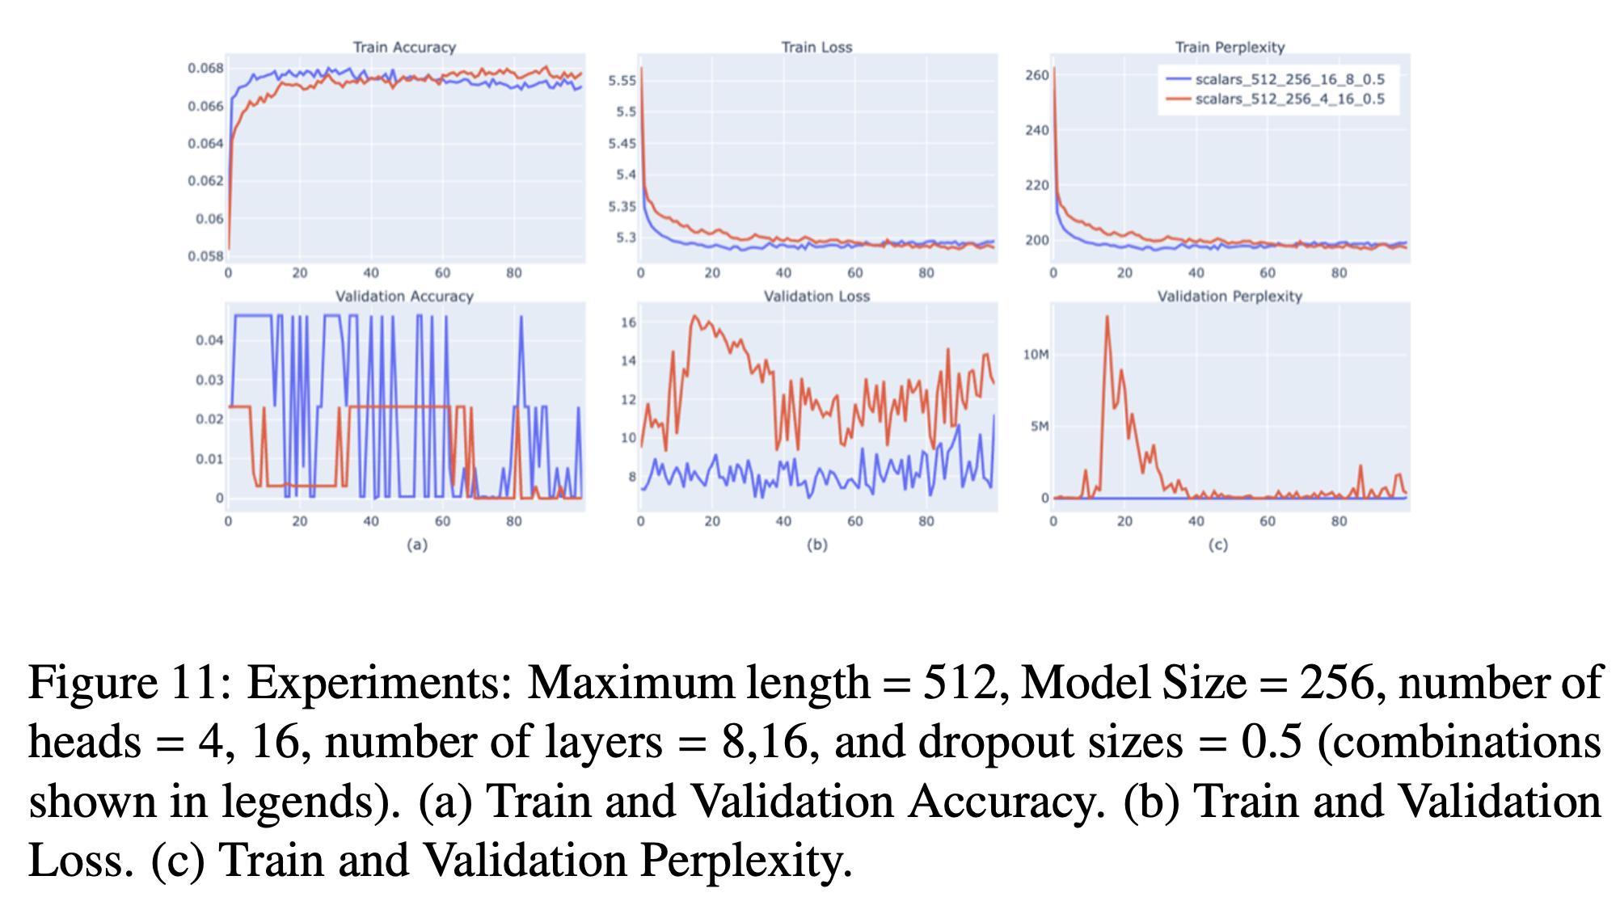
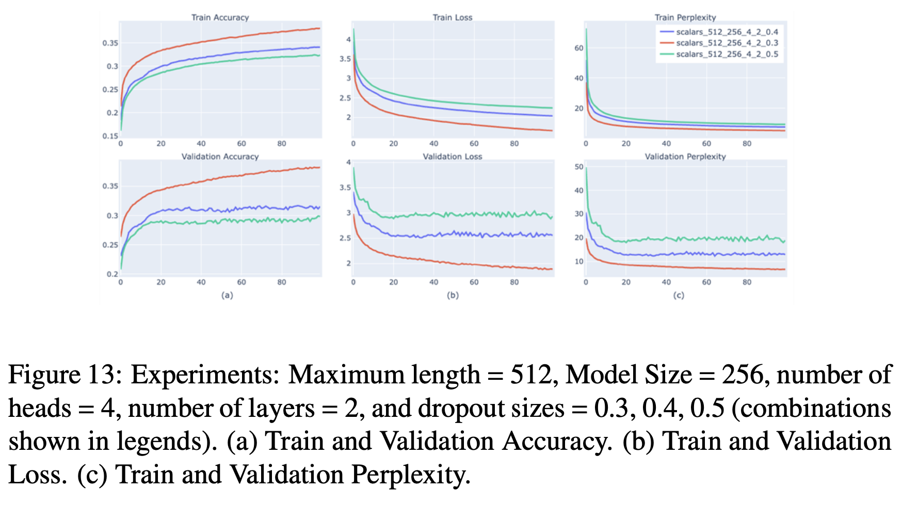
Results with model size 256

Slide 14
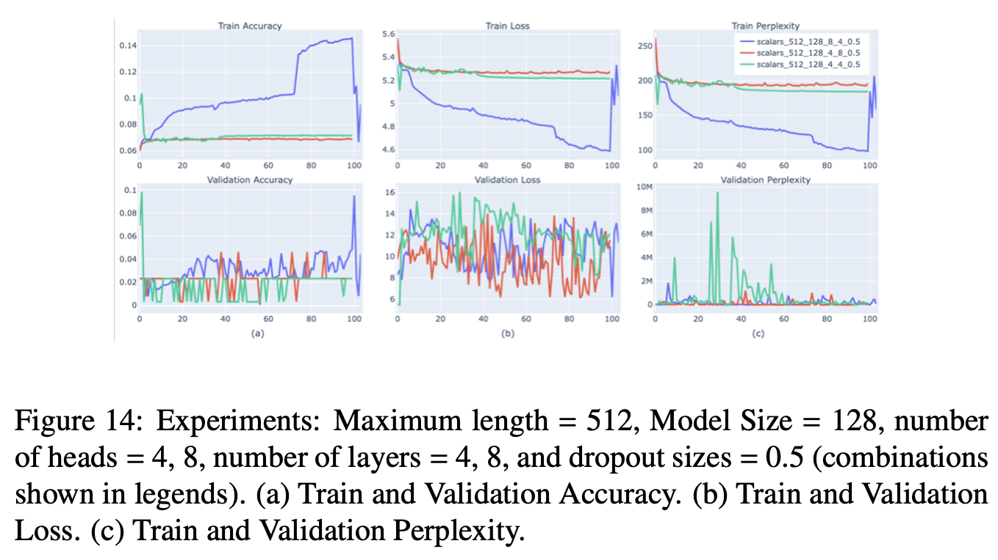
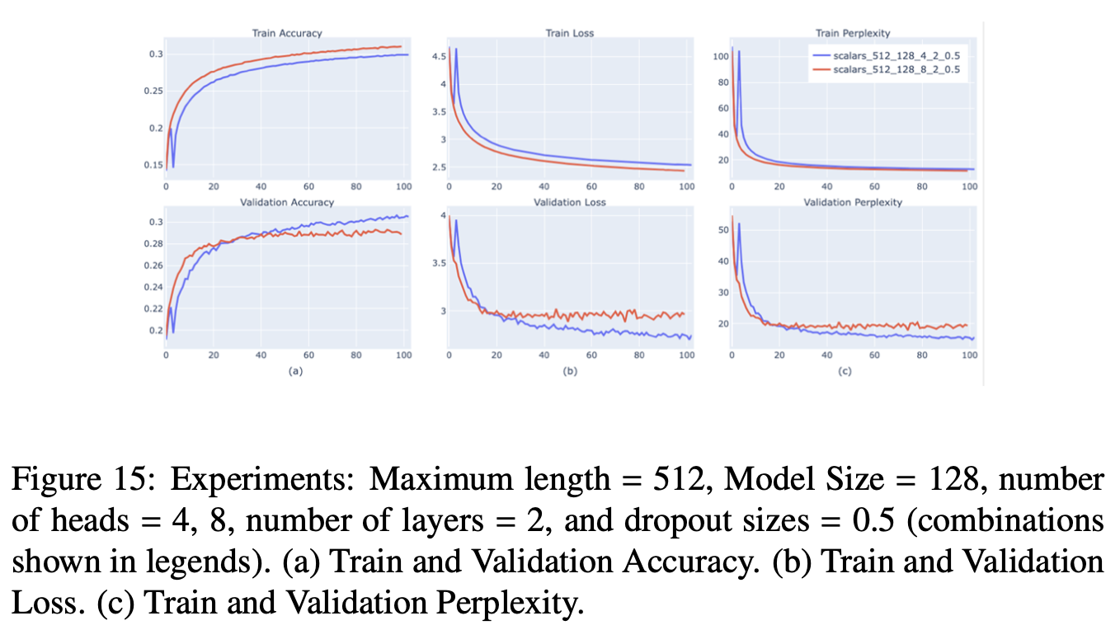
Results with model size 128

Slide 15
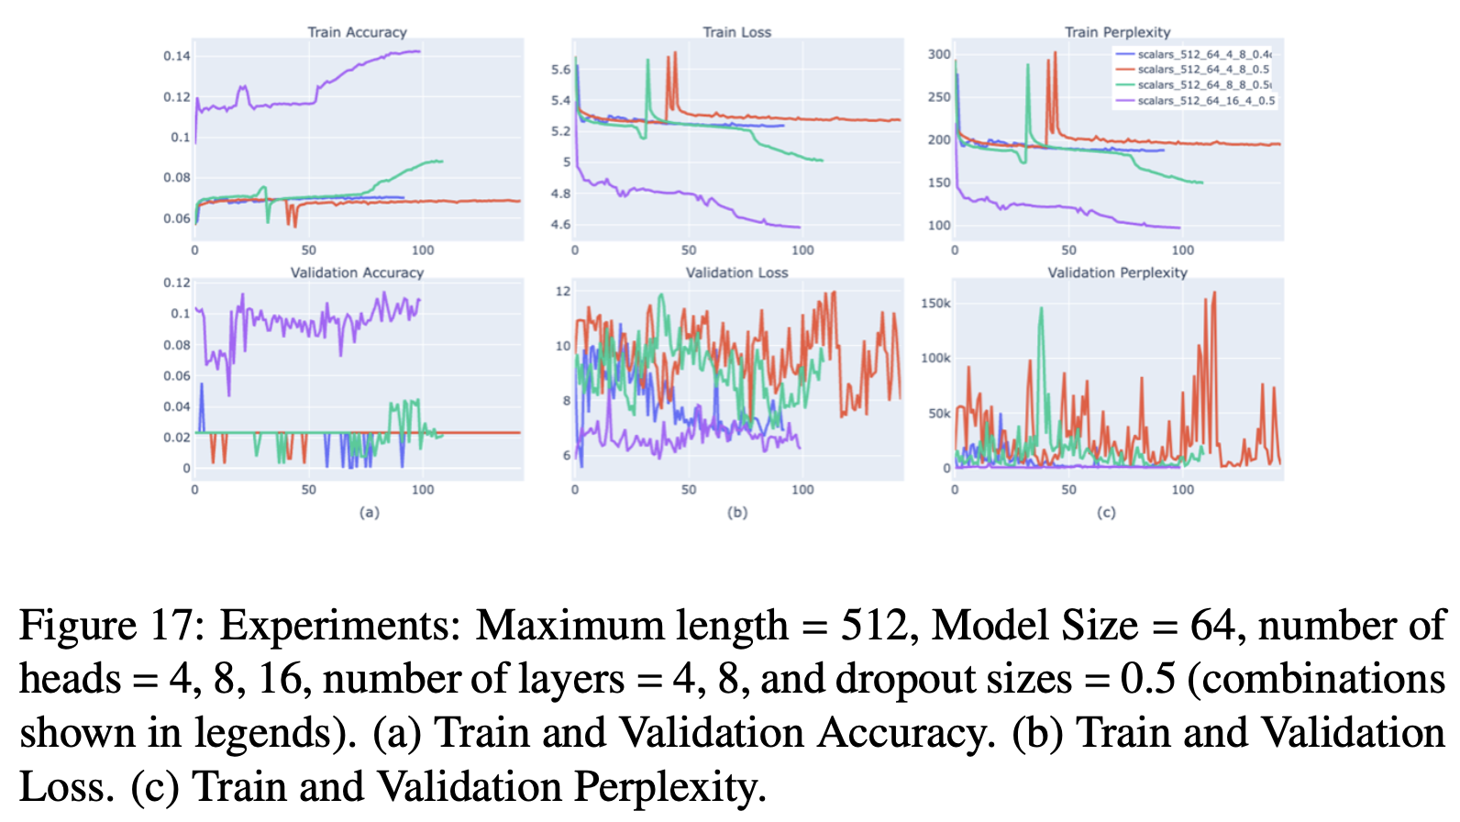
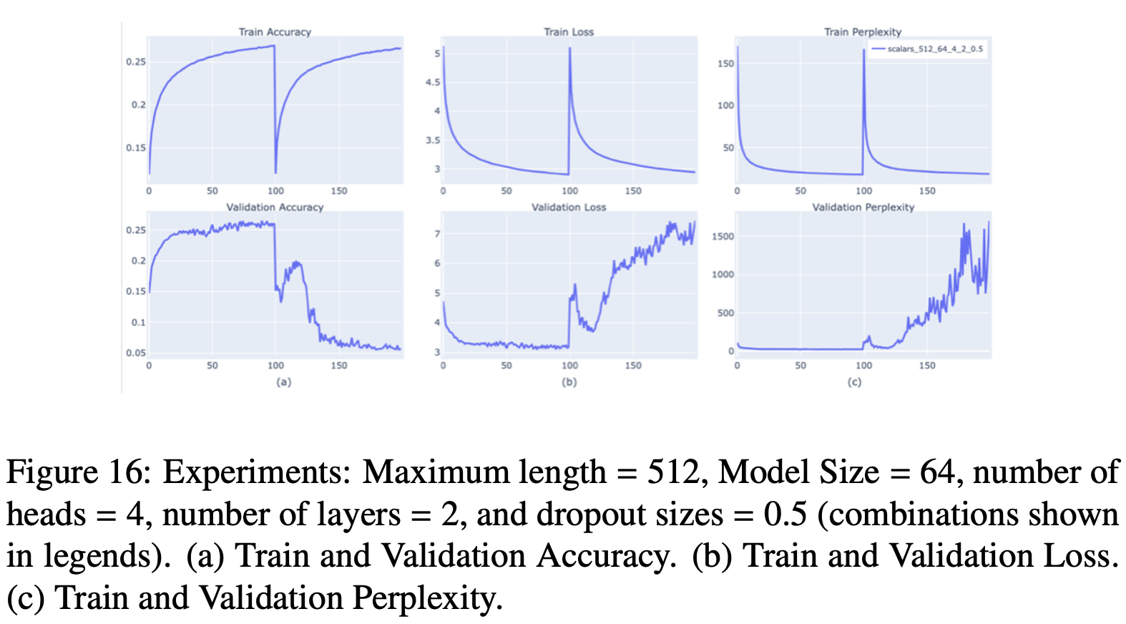
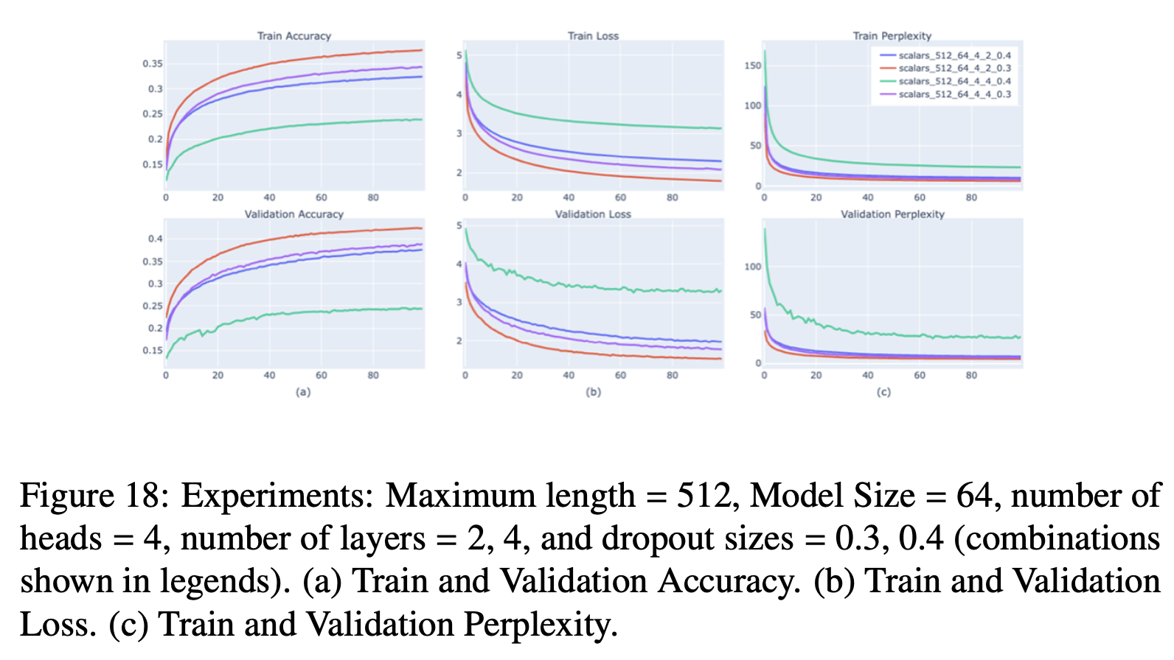
Results with model size 64

Slide 16
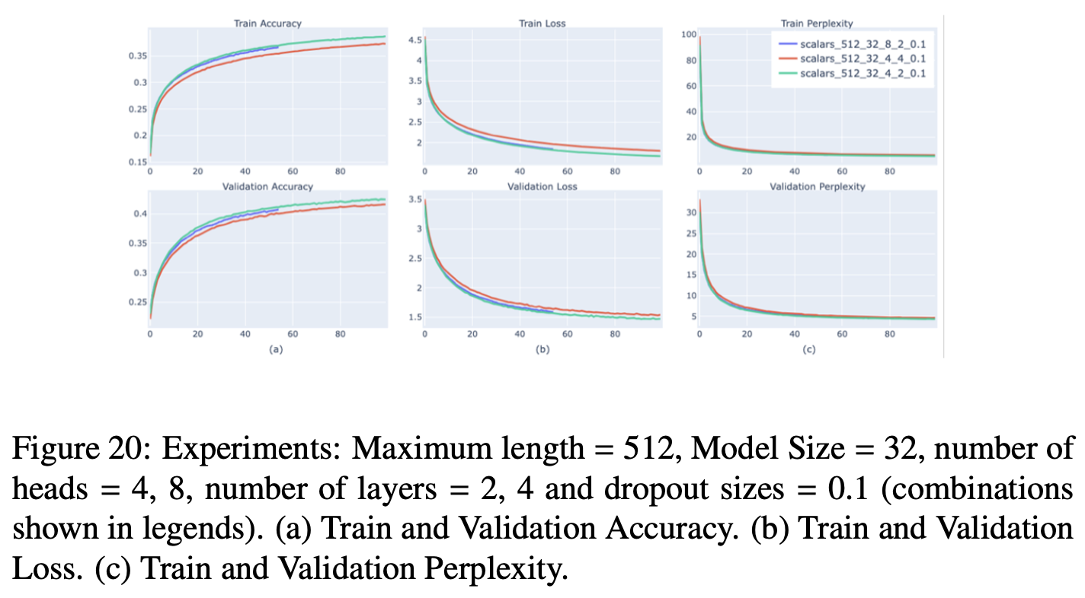
Results with model size 32

Slide 17
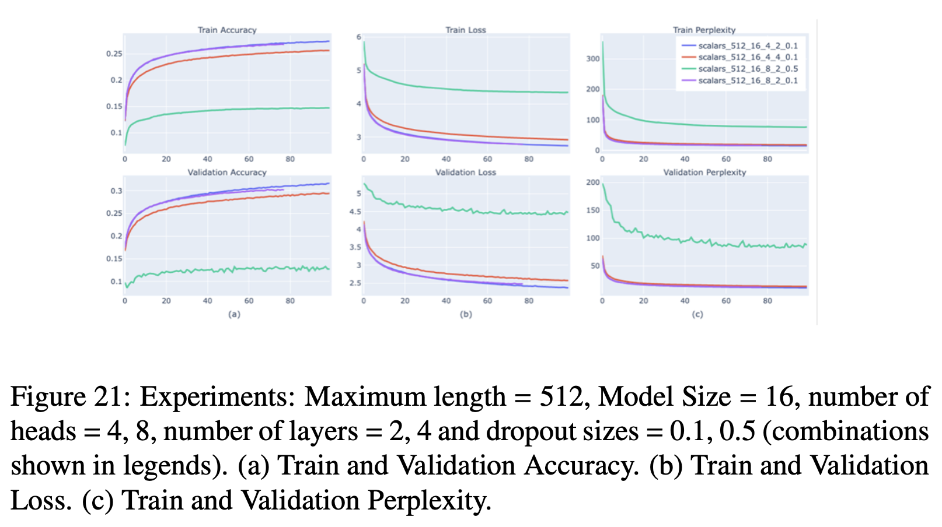
Results with model size 16

Slide 18
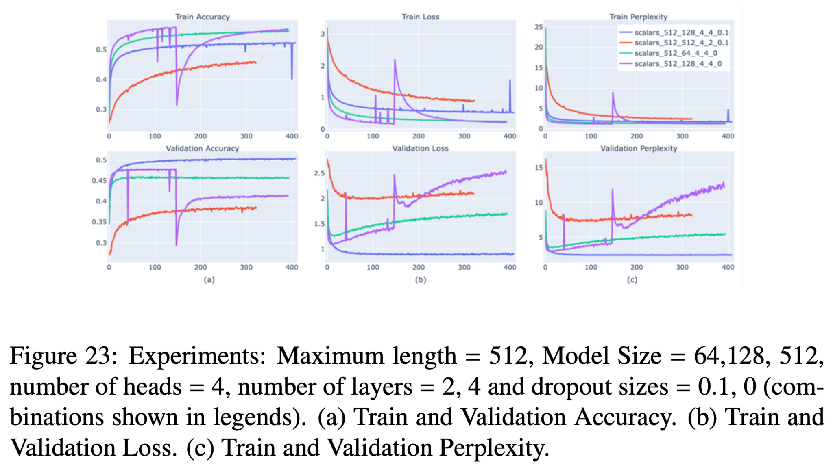
Best Results (After reducing dropout to 0)

Slide 19
Conclusion
Python Accelerated: CPU vs GPU
Role of Dropout
Model Complexity vs. Efficiency
Avoidance of Excessive Compute Power
Overfitting Trends
Influence of Heads and Layers
Evaluation Metrics and Perplexity
Advocacy for Thoughtful Tuning

Slide 20
Thank you!

